Slide 1
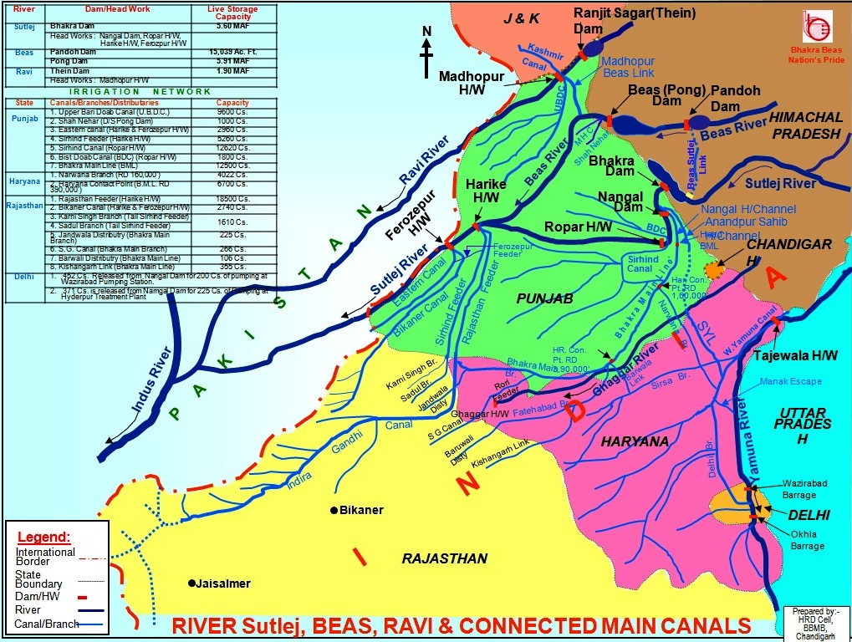
Reservoir Operations in Bhakra Beas River System

Slide 2
Height of Dam : 132.59 m (435 feet)
Gross Storage Capacity of Reservoir : 8570 million cu m (6.95 MAF)
Area of Reservoir : 260 Sq. km (100 Sq. Miles)
Length of Reservoir : 41.8 km (26 Miles)
Installed capacity : 360 MW (Uprated to 390 MW)
Height of Dam : 225.55 m (740 feet )
Gross Storage capacity : 9621 million m3 (7.80 MAF)
Area of Reservoir : 168.35 Sq. km. (65 Sq. Miles)
Length of the Reservoir : 96.56 km. (60 Miles)
Installed capacity : 1050 MW (Uprated to 1325 MW)
Height of Dam : 76.19 m (250 feet)
Water Conductor System : 37 km
Diversion : 8500 cusec
Generation capacity : 990 MW (6x165 MW)
BBMB – Responsible for:
Management and operation of
  Bhakra, Pong, Nangal and Pandoh Dams
Distribution of water from
  Ravi, Satluj and Beas Rivers
The need for Reservoir Planning
  For accurate inflow forecast at reservoirs
  Scenario generation for various forecasts
  Flood control and early warning systems
  Equitable distribution of water among partner states
Pandoh Dam
Bhakra Dam
Pong Dam

Slide 3
Long Term Planning
Based on historical Time-series of:
Inflow
Outflow/Demands
Reservoir Levels
Derived Inflow Patterns
Dry
Dependable
Mean
Different Scenarios Generated for Inflow Pattern and Demands(based on Irrigation Demands of stake holders and their share quota)

Slide 4
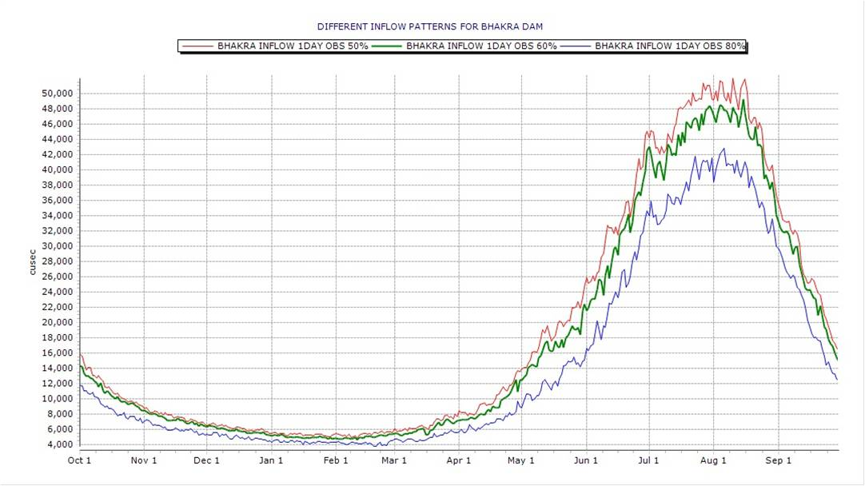
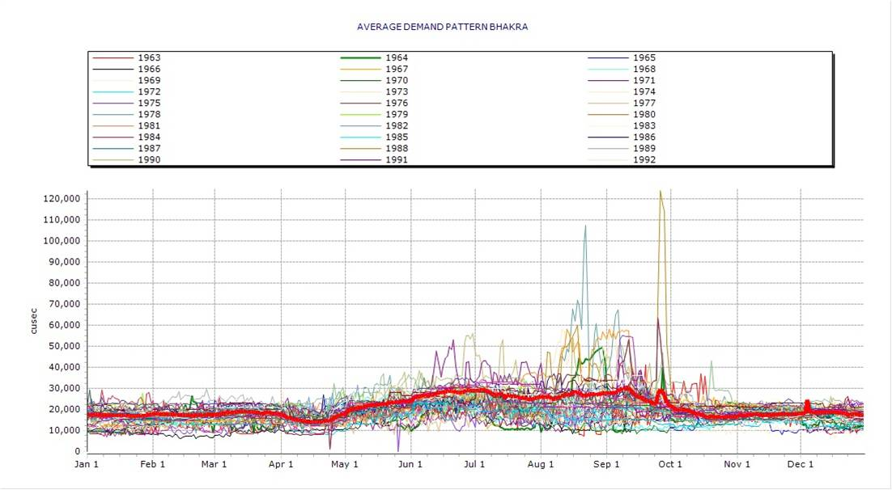
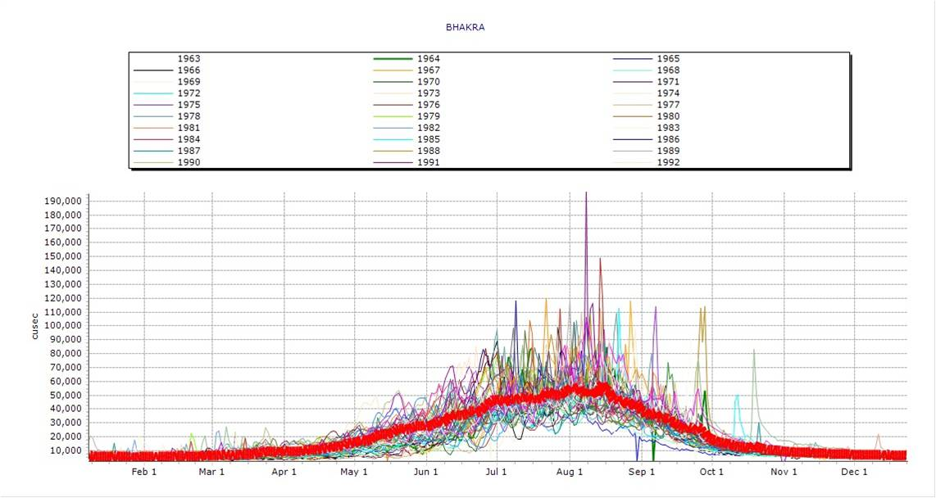
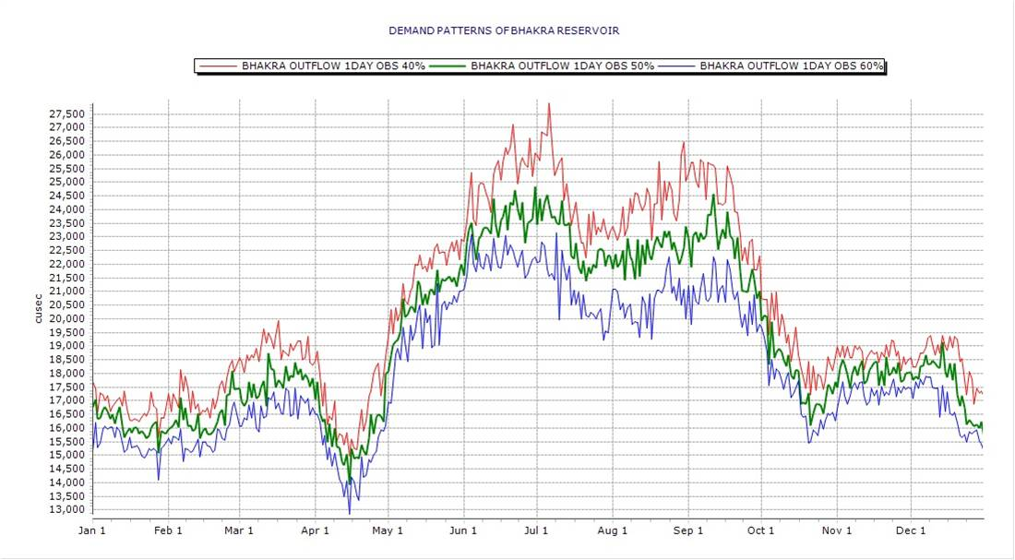
DERIVED INFLOW PATTERN OF BHAKRA FROM LONG TERM (30 YEARS )
DAILY TIME SERIES
DERIVED OUTFLOW PATTERN OF BHAKRA FROM LONG TERM (30 YEARS )
DAILY TIME SERIES
DRY DEPENDABLE AND MEAN INFLOW PATTERNS FOR BHAKRA RESERVOIR
DRY DEPENDABLE AND MEAN OUTFLOW PATTERNS FOR BHAKRA RESERVOIR

Slide 5
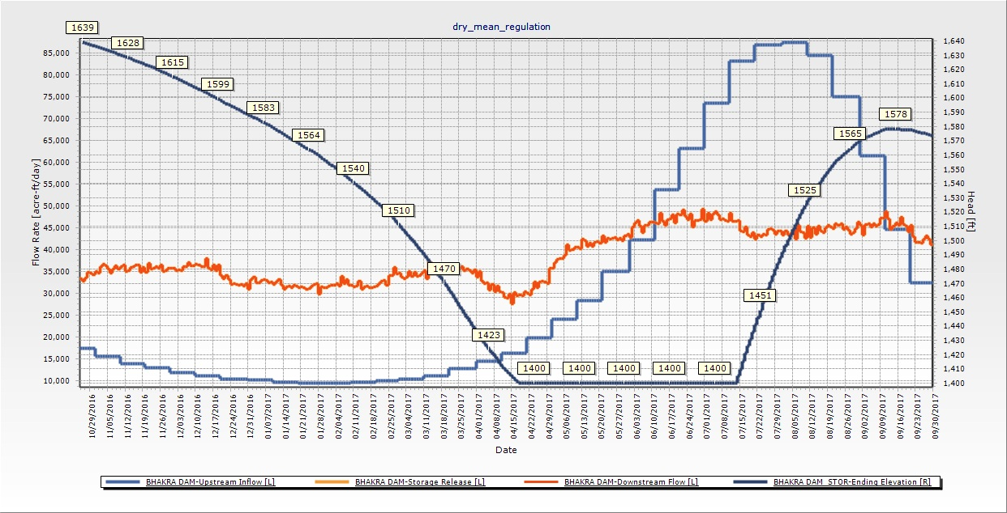
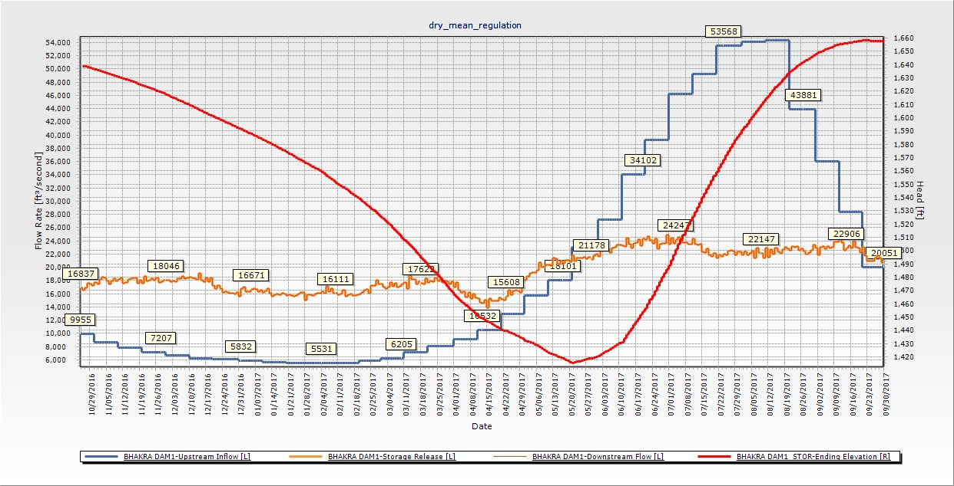
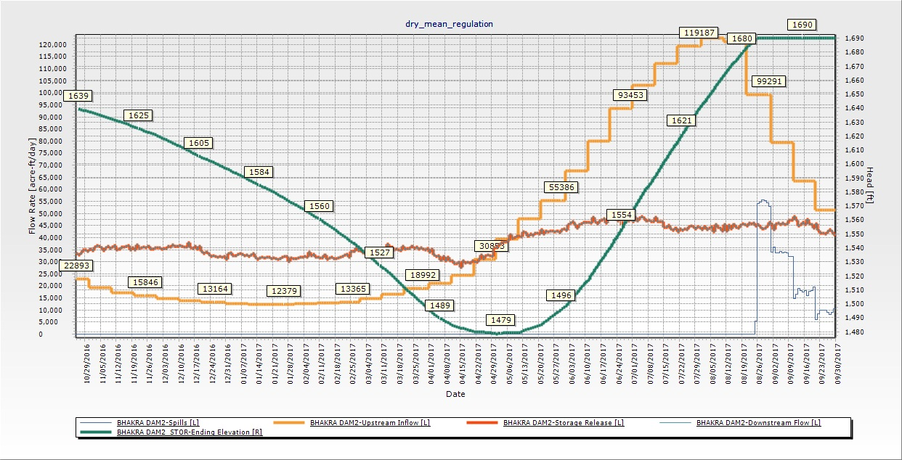
DEPENDABLE INFLOW PATTERN AND AVERAGE DEMANDS dependableinflow_averagedemand.xlsx
MEAN INFLOW PATTERN AND MEAN meaninflow_avdemand.xlsx
DRY INFLOW PATTERN AND AVERAGE dryinflow_averagedemand.xlsx

Slide 6
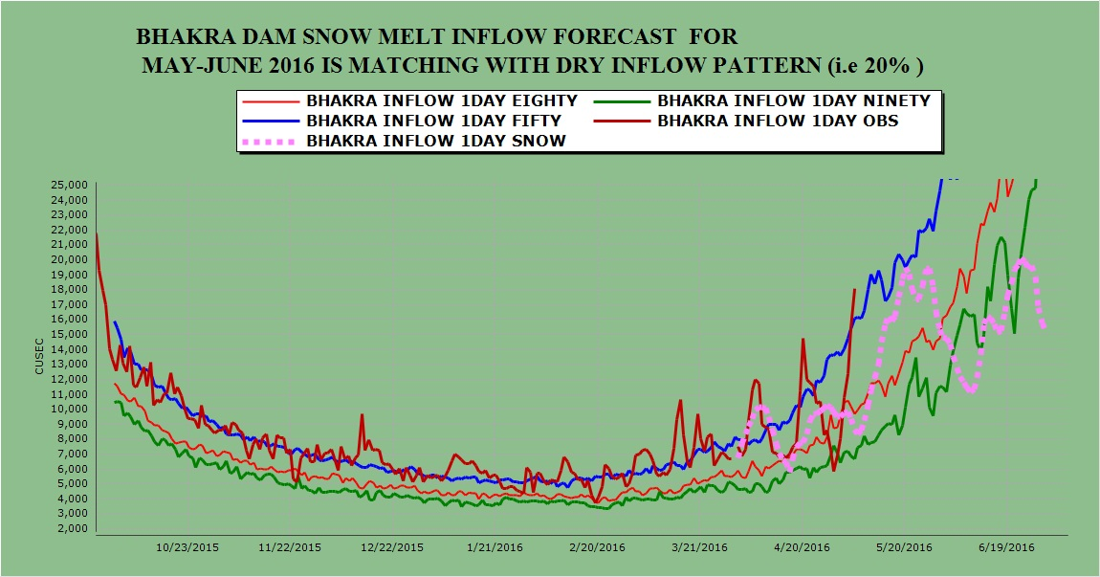
LINK E:\TCM\LINKS\BHAKRA_INFLOW_SNOW.xlsx
SNOW MELT FORECAST

Slide 7













Real time operations
SATELLITE
BBMB USERS
BBMB SERVER
(PROCESSING AND
MODELLING)
RECEIVING STATION
RT-DSS CENTER
BBMB WEB PORTAL
BBMB REMOTE STATIONS
FIREWALL
INTERNET SERVER
WEB USERS (INTERNET)

Slide 8
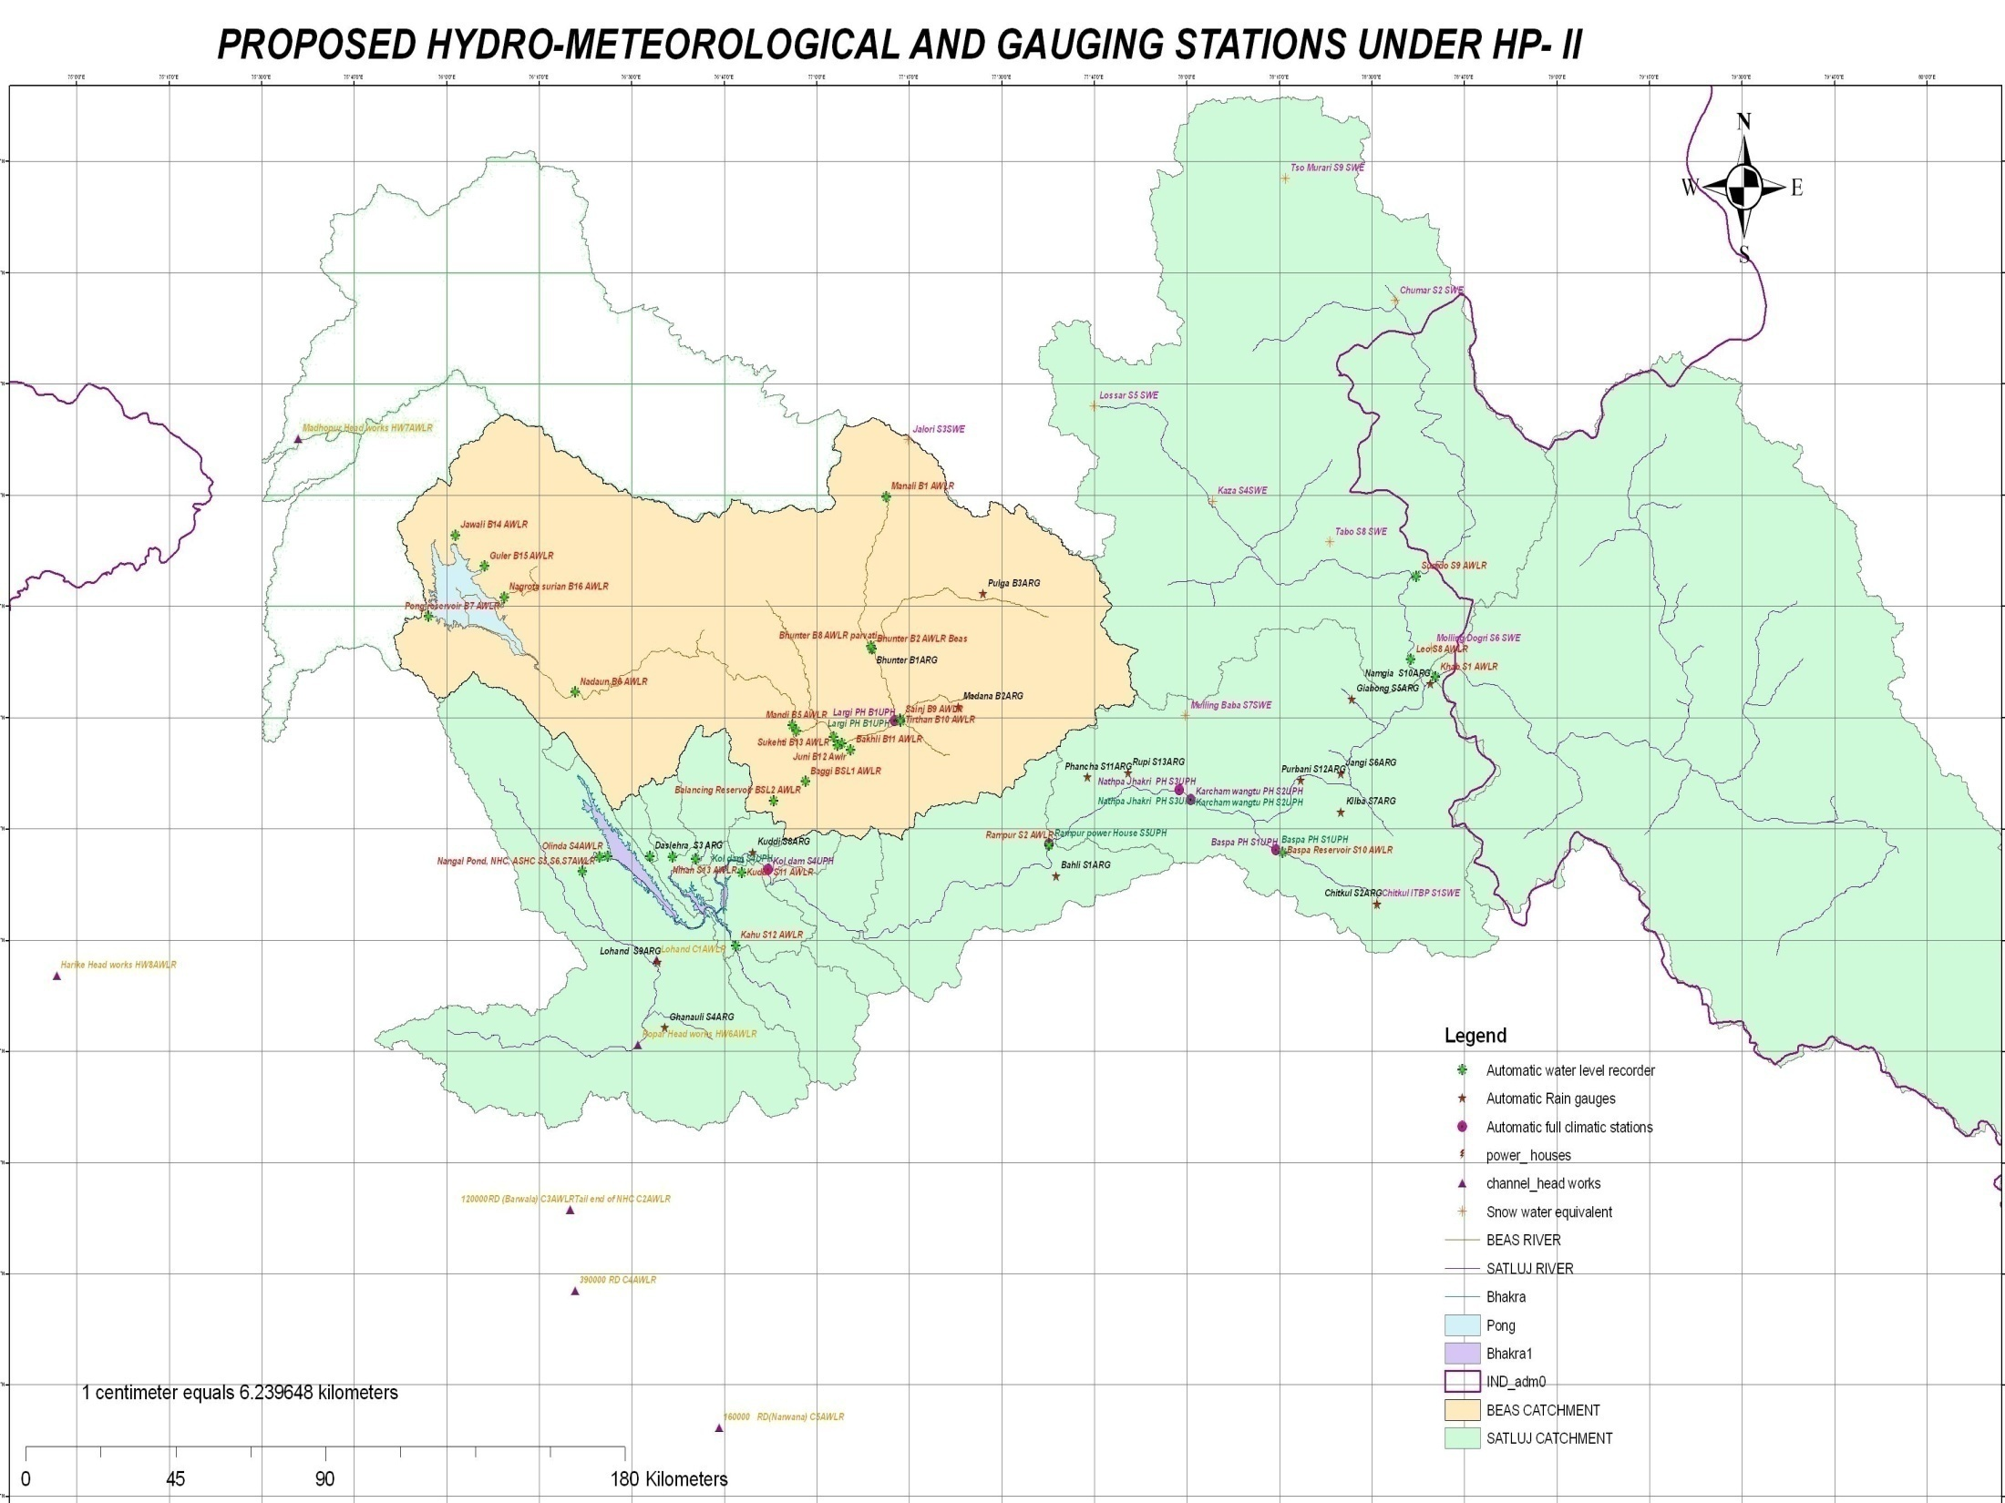
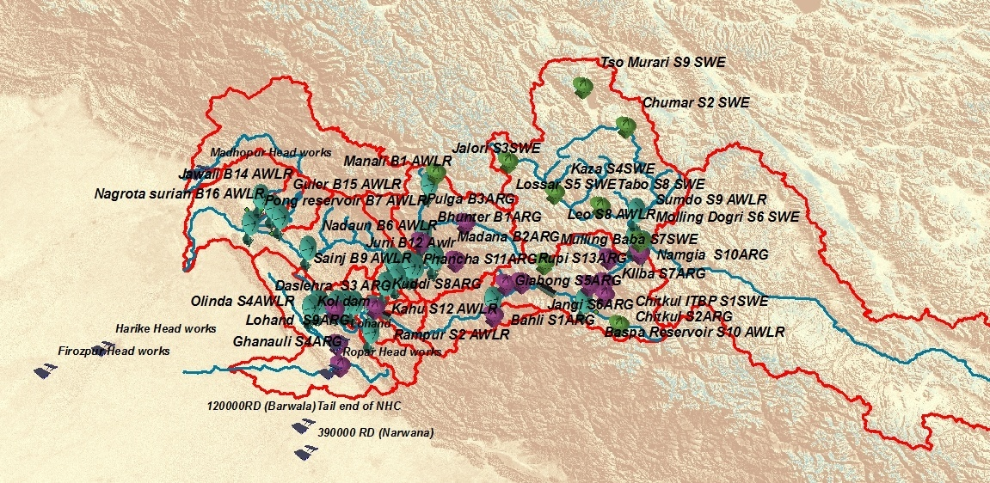
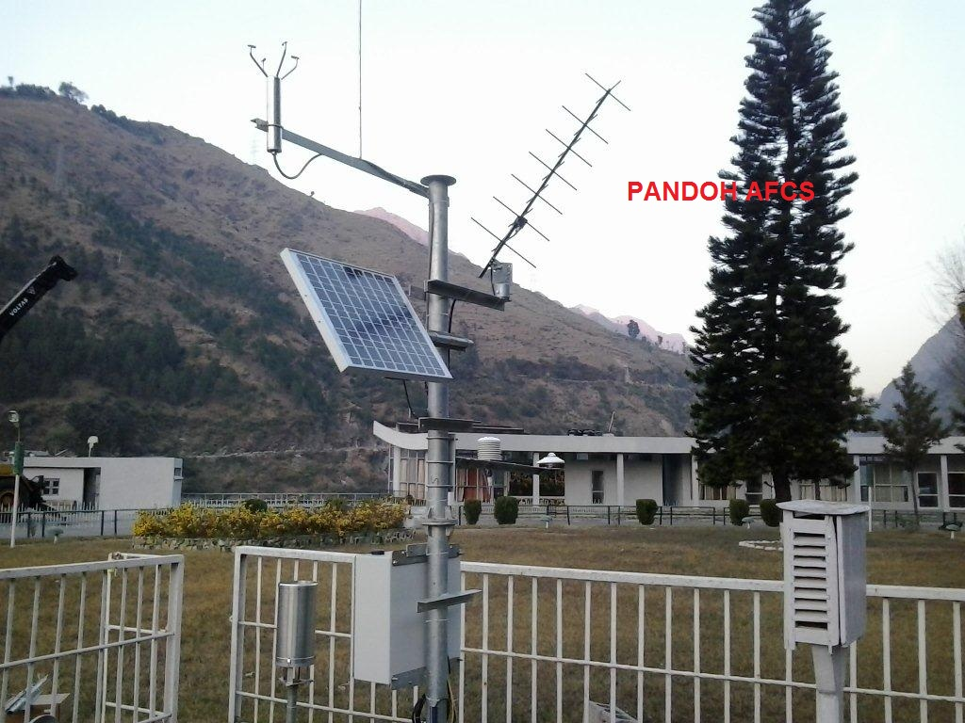
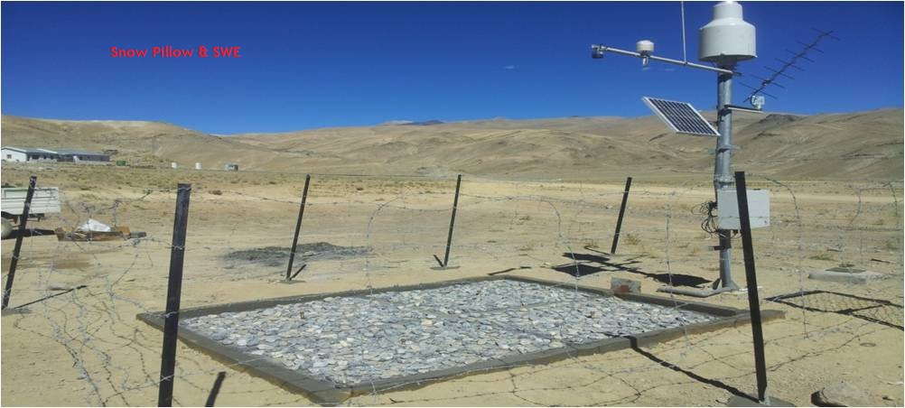
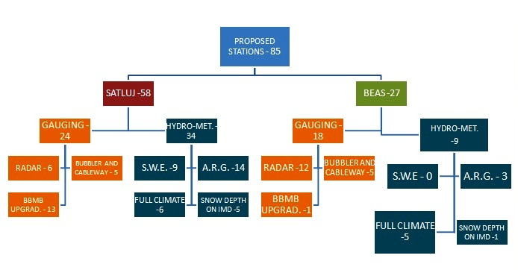
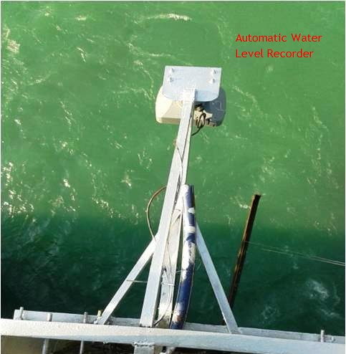
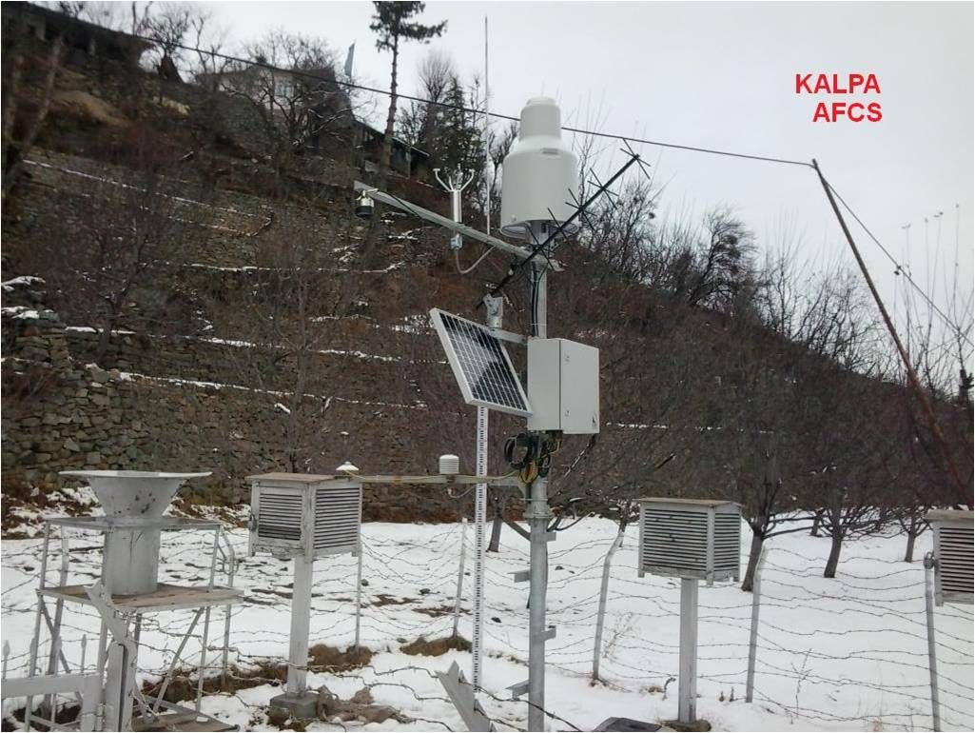
Data Acquisition System
Total Stations - 95

Slide 9
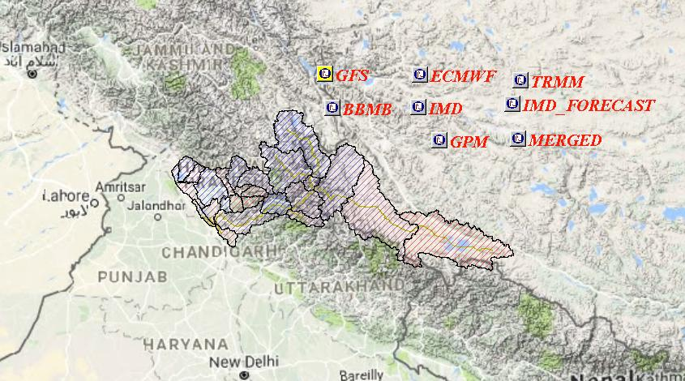
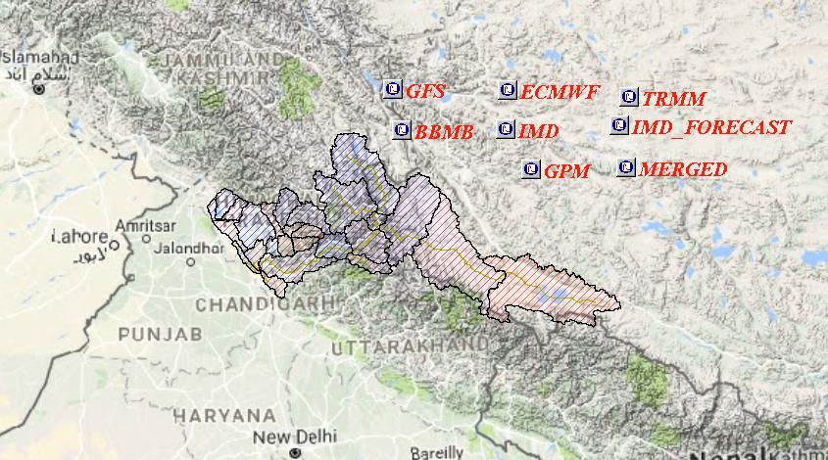


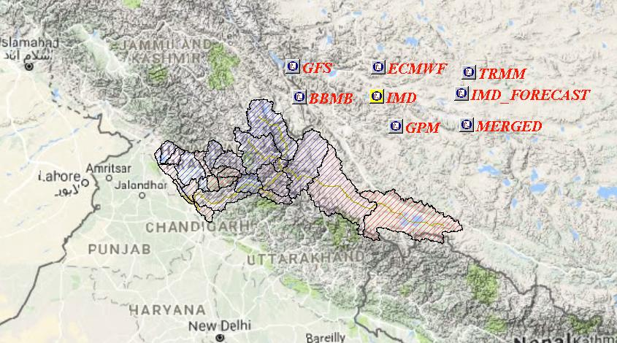

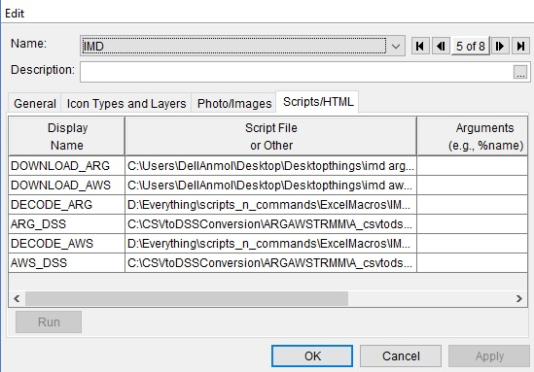
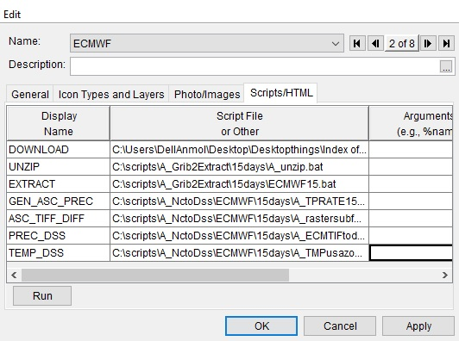
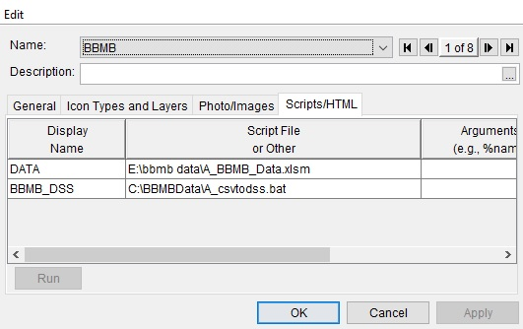
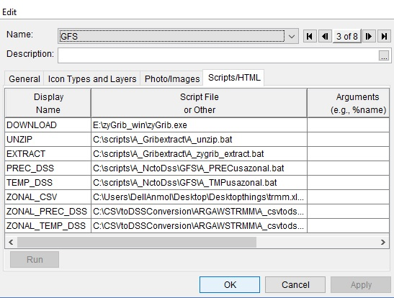
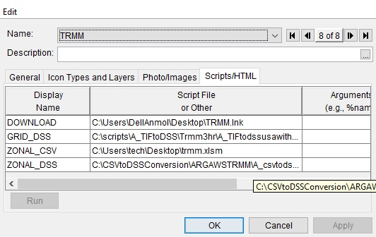
The Downloaded data from various sources reformatted by
pre-configured macro’s and python scripts

Slide 10
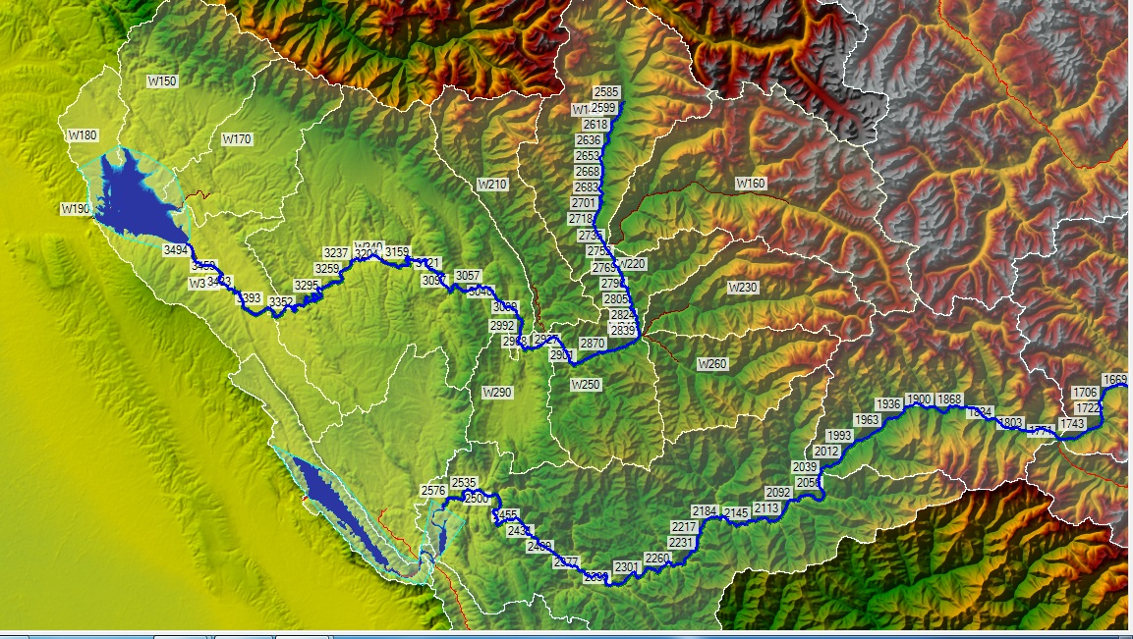
HYDRODYNAMIC MODEL
RESERVOIR-SIMULATION MODEL
HYDROLOGIC MODEL

Slide 11
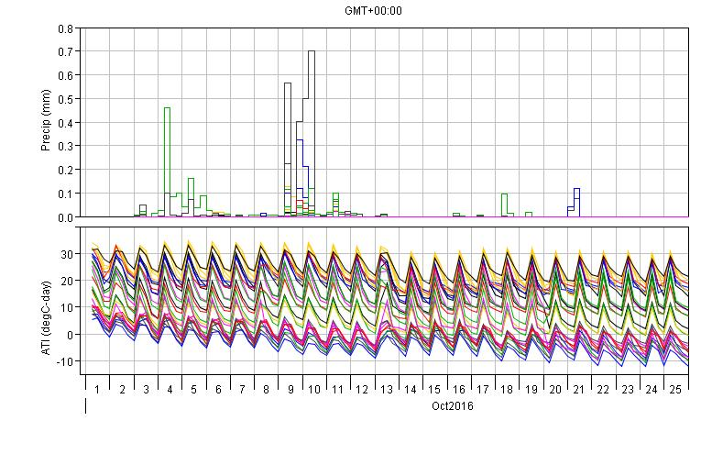
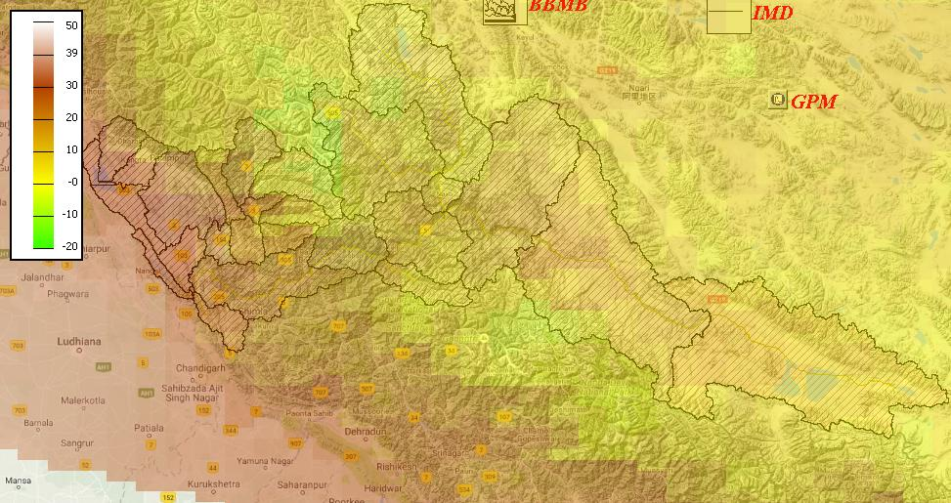
VISUALIZATIONS OF GRIDDED AND POINT DATA (REAL TIME & FORECASTED RECEIVED FROM DIFFERENT DATA SOURCES)
images\tabulate_data.xlsx

Slide 12
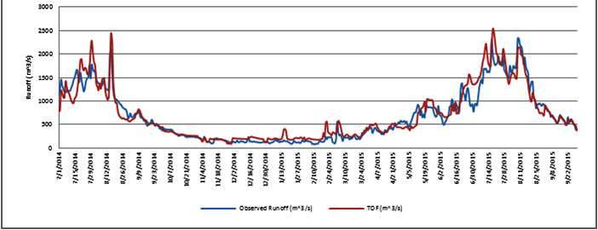
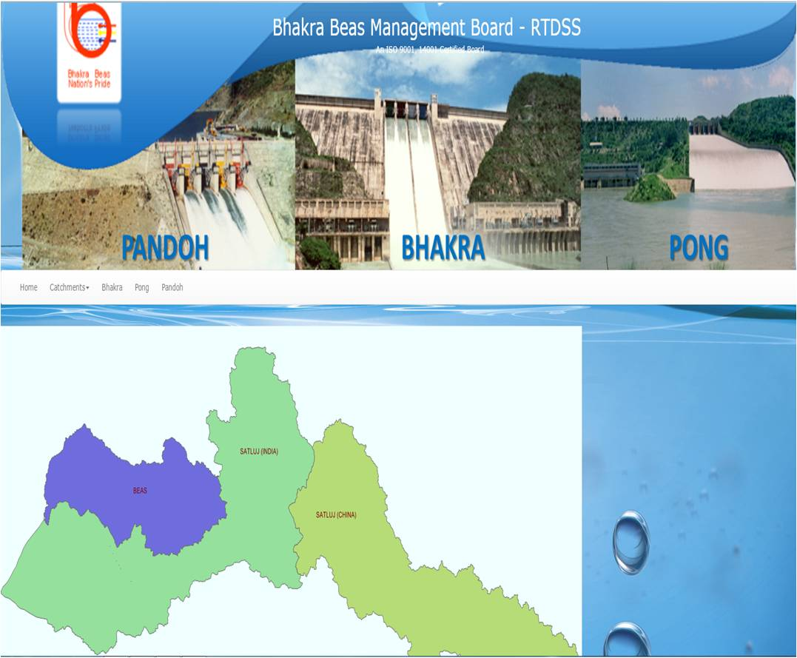
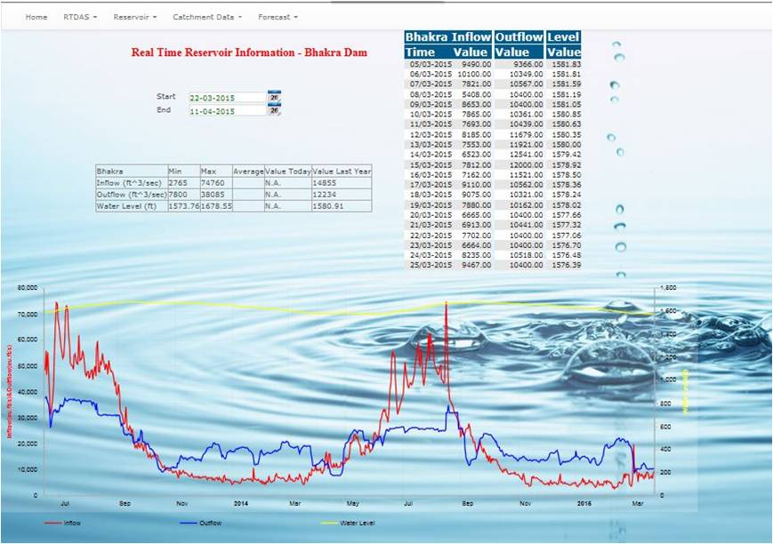
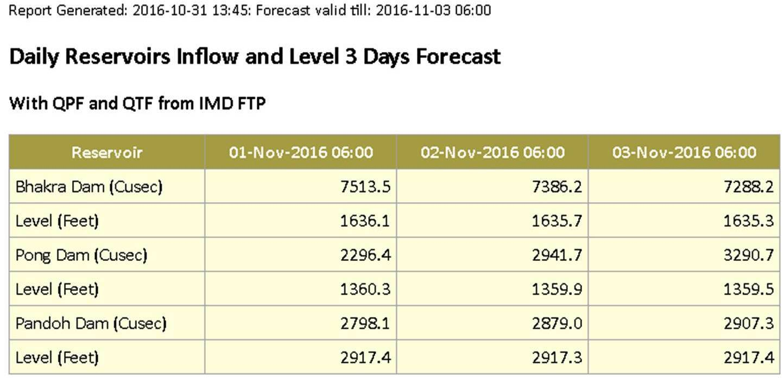
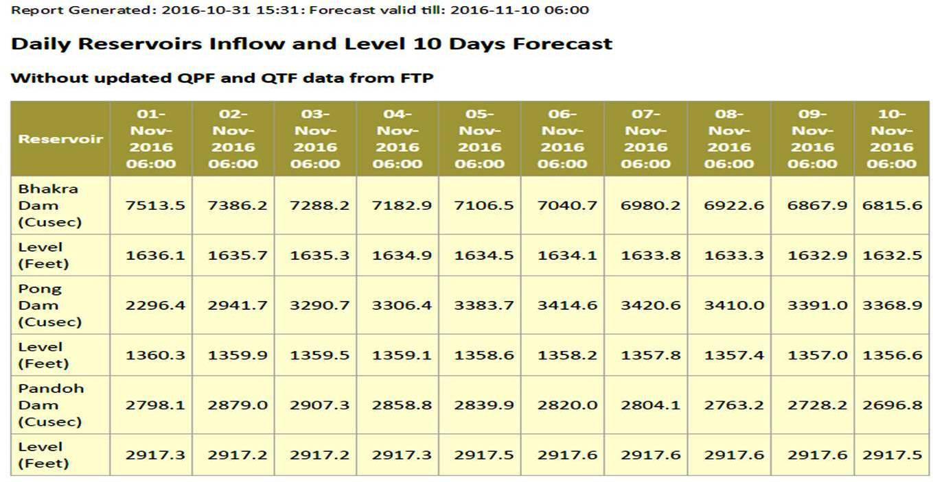
RESULTS VISUALIZATION AND DISSEMINATION
RESERVOIR OPERATION
( INFLOW, OUTFLOW & LEVEL)
WEBSITE – DASHBOARD
SHORT TERM FORECAST
MEDIUM TERM FORECAST
OBSERVED vs SIMULATED at TOF
WEBSITE
DASHBOARD
RESERVOIR OPERATION
( INFLOW, OUTFLOW & LEVEL)
INFLOW FORECAST
(SHORT & MEDIUM TERM)
OBSERVED vs SIMULATED

Slide 13
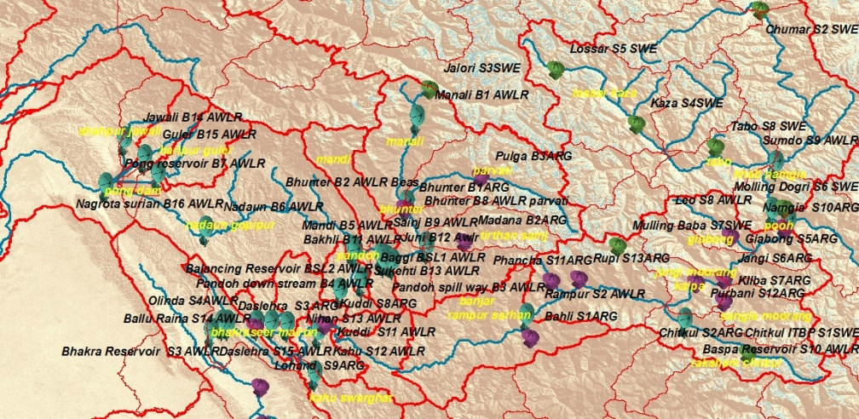
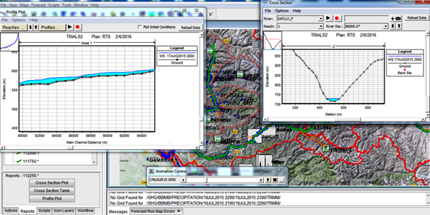
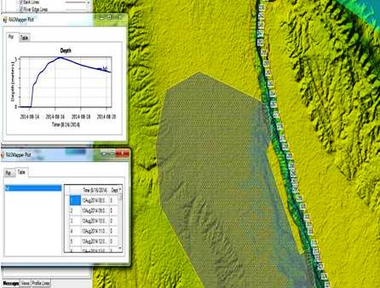
HYDRODYNAMIC MODELLING RESULTS AND ANIMATIONS
THE FULL NETWORK OF BBMB (SATLUJ AND BEAS BASIN) CAN BE TRACKED REAL TIME WITH THE VARIOUS SENSORS PLACED IN THE BASIN AND MODEL OUTPUTS
Tracking_animation1.avi
1 D HYDRODYNAMIC MODEL PROFILES RIVER L-SECTION AND X-SECTIONS
longi_profile.avi
2-D FLOOD MODELS FOR THE FLOOD PRONE AREAS D/S OF RESERVOIRS
2016-02-15 at 20-46-46.mp4

Slide 14
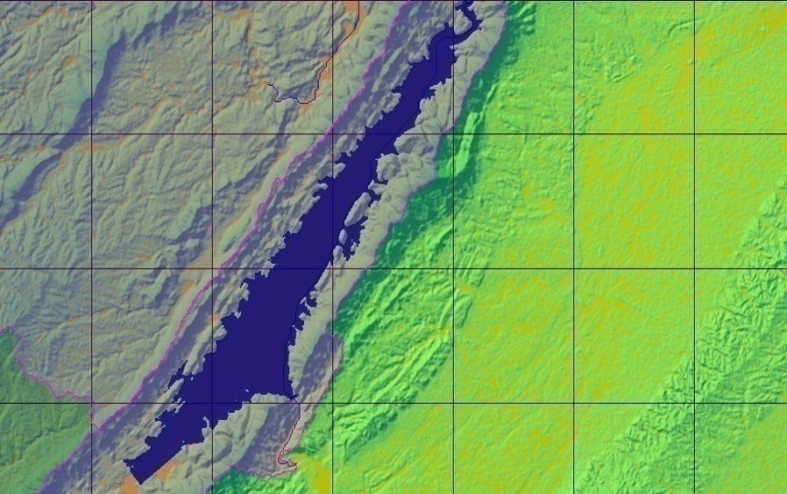
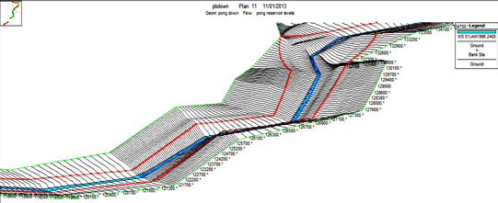
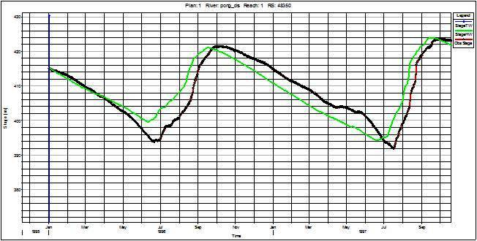
RAS MAPPER AND RIVER PROFILES
THE RIVER PROFILE WITH TERRAIN CAN BE SEEN RAS MAPPER
profile 1d.mp4
RIVER PROFILE ANIMATION
.river animation.avi
RESERVOIR LEVELS FOR THE FORECASTED INFLOWS AND OUT FLOWS CAN BE SIMULATED IN THE HYDRO DYNAMIC MODEL
Ras pong dam.avi

